Slide 1
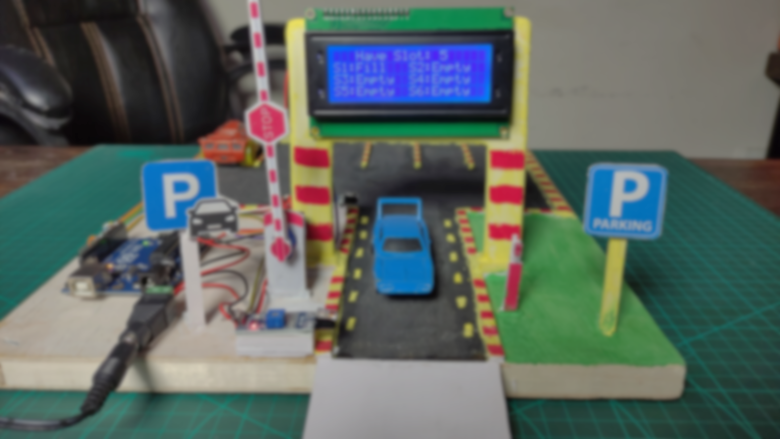

Automatic Car Parking System

Slide 2
Hridita Barua
20200104052
Sowpnil Roy
20200104071
Presented By
Mymona
Akter
20200104069
Arif Rayhan
Pran
20200104058
Jannatul Maowa Ahona
20200104055

Slide 3
Abstract
In this Arduino based project we will implement a smart car parking system.
It can be concluded that with the correct connection of some simple electrical
components, it is possible to create an automatic car parking system, thus
decreasing aimless driving, saving our time, as well as making the process of
parking simple. This system will ensure the safety of the vehicles. Our users can
make their vehicles safe & secure by using this system.

Slide 4
Social Values
Our traffic is increasing day by day. If we can implement this project,
we will be able to easily park many cars in less space and it will be
easier to ensure the safety of our vehicles. This project will make
our life easier. This is very affordable. Project management costs are
also very low. Anyone can use it easily.

Slide 5
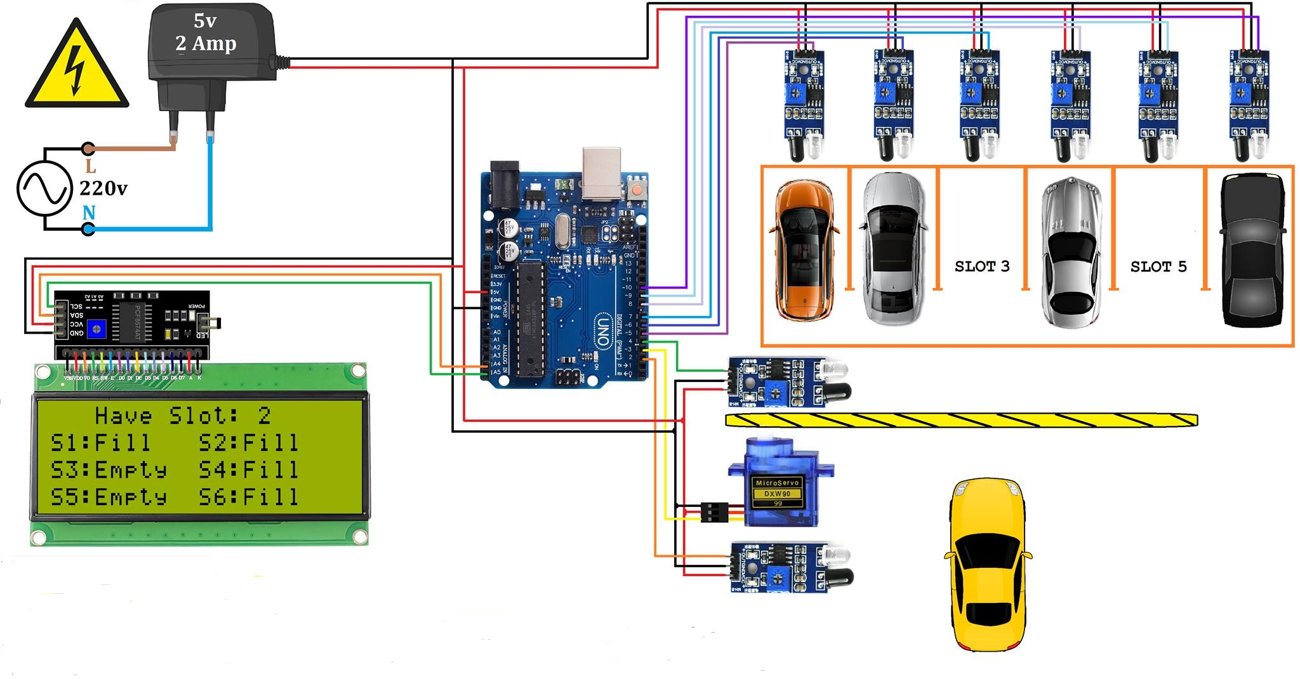
circuit diagrams

Slide 6
Equipment List
Arduino UNO
Alphanumeric LCD Display 20*4
Arduino LCD Display 16*2
IR Range Sensor 8
Micro-Servo Motor
Connector Adapter DC Power 2.1 mm
Digital 5v 2A Switching Power Supply
Breadboard
Necessary wires & Others
Hard Board

Slide 7
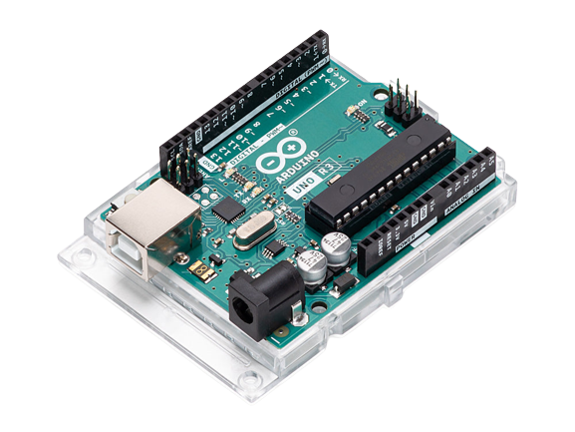
Arduino UNO
The Arduino Uno is an open source
microcontroller board based on the
Microchip at mega 328P microcontroller and
developed by Arduino.
This system is capable of finding the empty
slots that are available for parking
automatically. If the slot is empty in the
automated car parking the new vehicles are allowed
to enter the parking else the entrance is blocked by using
Arduino UNO.

Slide 8
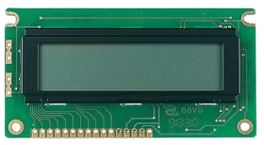
Alphanumeric LCD Display 20x4
Raystar provides various LED backlight combinations for RC2004B 20x4 LCD
module, such as yellow-green and white. You can choose module with LED
backlight or without it.
LED backlight can be driven
By PIN1, PIN2, PIN15, PIN16 or
A and K.

Slide 9
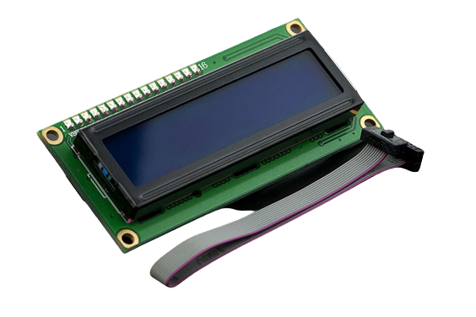
I2C 16x2 Arduino LCD Display Module
To display the parking status we are using a
12C 16x2 Arduino LCD Display Module

Slide 10
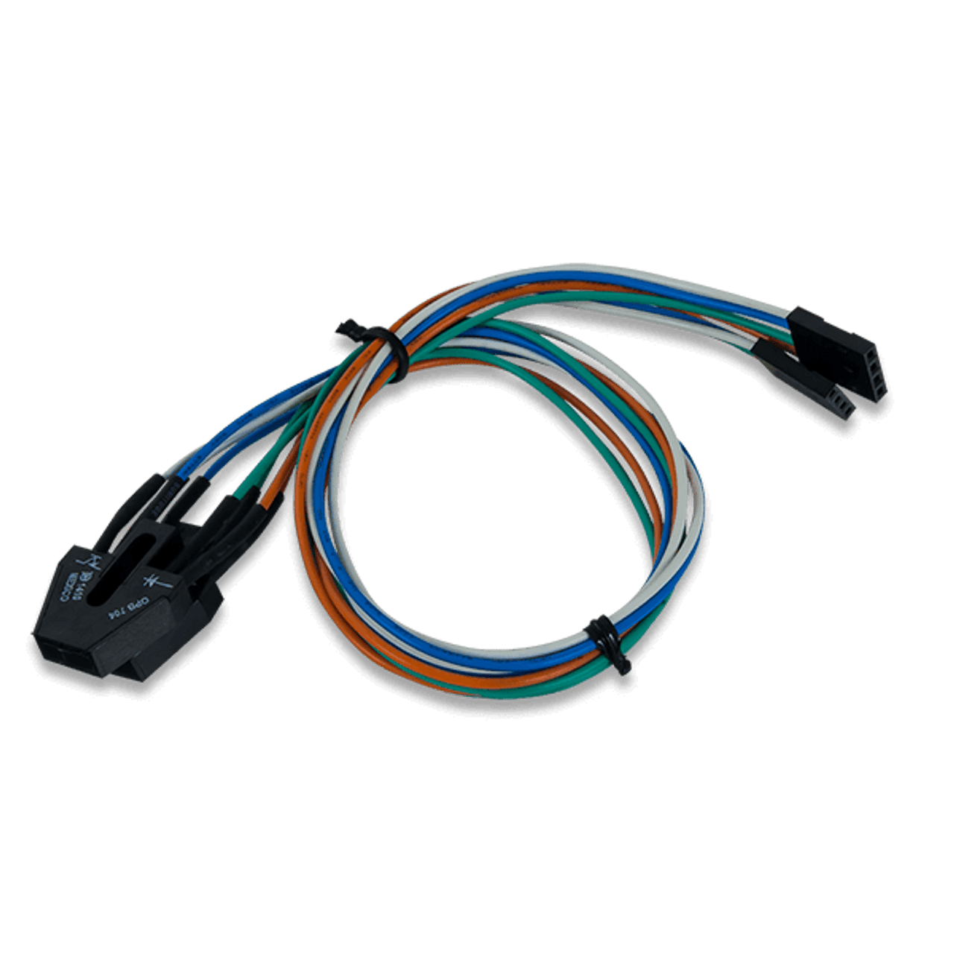
IR Sensor
For detecting the movement of vehicles,
we are using the IR sensors

Slide 11
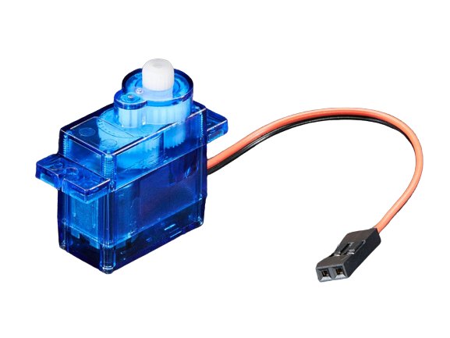
Servo Motor
Servos are mainly used on angular or linear position
and for specific velocity, and acceleration.

Slide 12
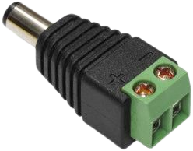
Connector Adapter
Connectors and adapters enable you to stream data
into or out of an event stream processing engine.

Slide 13
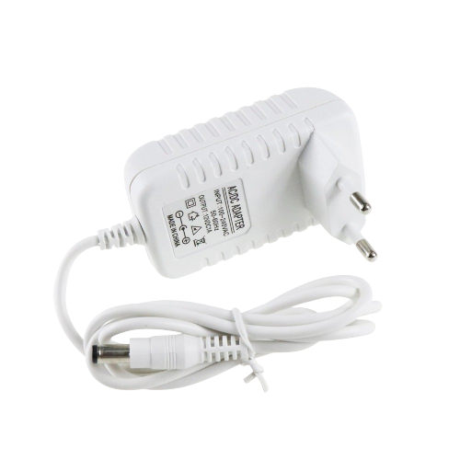
5V 2.5A Switching Power Supply
A power supply is an electrical device that supplies
electric power to an electrical load. The main purpose
of a power supply is to convert electric current from
a source to the correct voltage, current, and
frequency to power the load.

Slide 14
No of Equipment | Necessary Equipment | Budget
1 | Arduino Uno | 1450
2 | Alphanumeric LCD Display 20*4 | 650
3 | Arduino LCD Display 16*2 | 500
4 | IR Range Sensor 8 | 1000
5 | Micro-Servo Motor | 200
6 | Connector Adapter DC Power 2.1 mm | 300
7 | Digital 5v 2A Switching Power Supply | 250
8 | Breadboard | 150
9 | Necessary wires & Others | 550
10 | Hard Board | 200
Total |  | 5150
Estimated Budget

Slide 15


Mr. Farzad Ahmed
Lecturer
CSE, AUST
Ms. Ashna Nawar Ahmed
Lecturer
CSE, AUST

Slide 16

Any Questions???

Slide 17

Thank
You!!!

